Slide 1
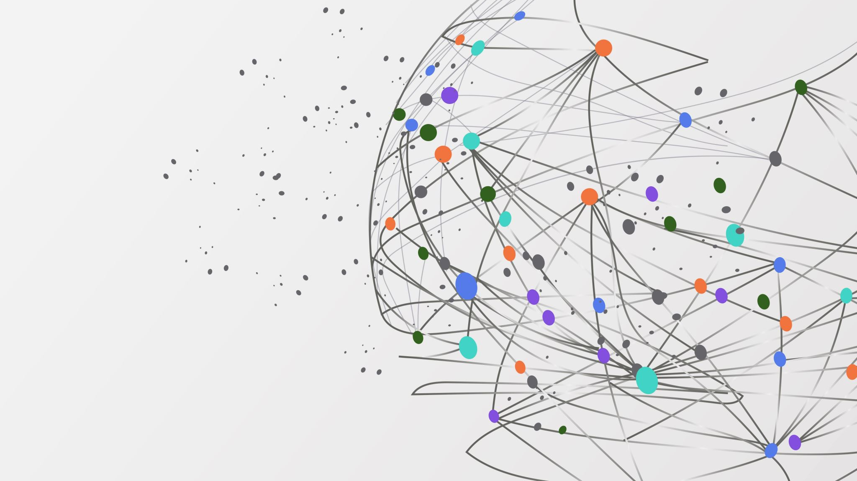
Application Layer Unit- 6
By
Dr Sanjeev Kumar Mandal

Slide 2

Application Layer:
In the OSI model, the application layer is the layer closest to the end-user, implying that the application layer and the end-user can interact directly with the software application.
The application layer isn't an application. Instead, it's a component within an application that manages how data is sent to and received from other devices.
It's an abstraction layer service that hides the rest of the program from the transmission.

Slide 3
Application Layer
The application layer is the topmost layer of the OSI model and the TCP/IP model. In TCP/IP model, the application layer is formed by combining the top three layers, i.e., the application layer, the presentation layer, and the session layer.
An application layer is an abstraction layer that specifies the shared communications protocols and interface methods used by hosts in a communications network.
It is the layer closest to the end-user, implying that the application layer and the end-user can interact directly with the software application.

Slide 4
Application Layer
Consumers frequently require protocols from the Application Layer.
One of the most often used application protocols is HTTP (HyperText Transfer Protocol), the foundation for the World Wide Web. Domain Name System (DNS), Simple Mail Transfer Protocol (SMTP), File Transfer Protocol (FTP), Trivial File Transfer Protocol (TFTP), and TELNET are some of the protocols used in the application layer.

Slide 5
Application Layer Services
The application provides the following services.
The application layer guarantees that the receiver is recognized, accessible, and ready to receive data from the sender.
It enables authentication between devices for an extra layer of network security.
It determines the protocol and data syntax rules at the application level.
The protocols of the application layer also define the basic syntax of the message being forwarded or retrieved.
It also checks whether the sender's computer has the necessary communication interfaces, such as an Ethernet or Wi-Fi interface.
Finally, the data on the receiving end is presented to the user application.

Slide 6
Functions of the Application Layer
The Application Layer provides protocols that allow the software to communicate and receive data and finally present it to users in a meaningful way.
This layer allows users to log on as a remote host.
The Application Layer provides various facilities for users to forward multiple emails and a storage facility.
This layer acts as a window via which users and application processes can access network resources.
This layer provides services such as email, file transfer, results distribution, directory services, network resources, etc.
The application layer communicates with the operating system and guarantees that data is properly saved.
This layer allows users to interact with other software applications.
This application layer generally performs host initialization followed by remote login to hosts.
This layer visualizes data, allowing individuals to grasp it rather than memorize it or see it in binary format (1s or 0s).

Slide 7
Application Layer Protocols
HTTP: Hypertext transfer protocol
SMTP: Simple Mail Transfer Protocol
TELNET:
FTP: File Transfer Protocol
TFTP: Trivial File Transfer Protocol
NFS: Network file system
DNS: Domain Name System
DHCP: Dynamic Host Configuration Protocol

Slide 8
Telnet
Telnet provides a connection to the remote computer in such a way that a local terminal appears to be at the remote side.
There are two types of login:
Local Login
Remote login

Slide 9
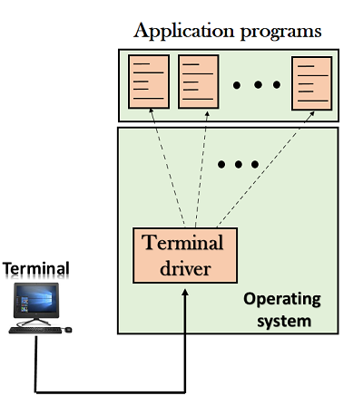

Slide 10
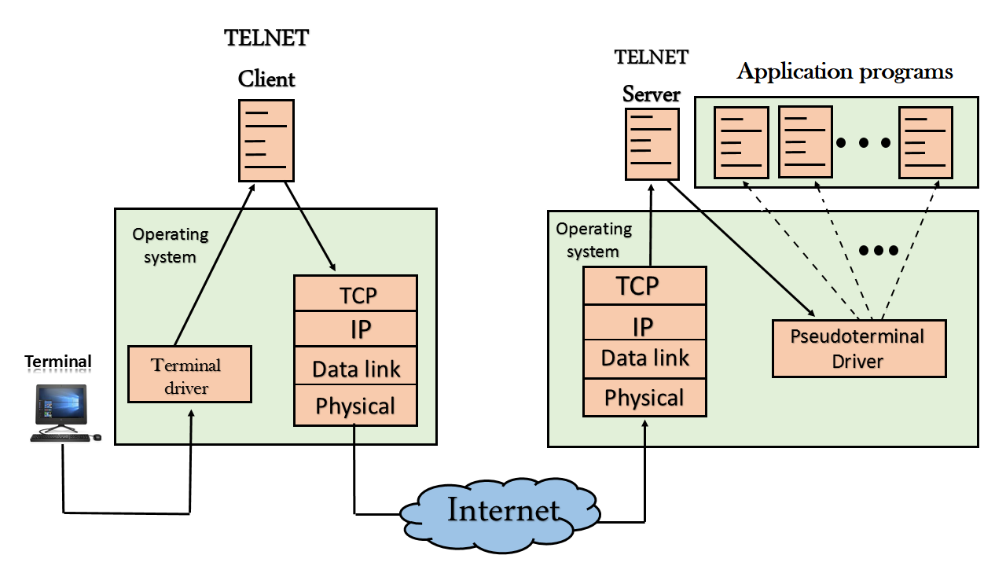

Slide 11
Network Management System:
A network management system (NMS) is an application or set of applications that lets network engineers manage a network's independent components inside a bigger network management framework and performs several key functions.

Slide 12
Simple Network Management Protocol
SNMP is used at the application layer of the TCP/IP architecture and, as the name implies, it is used to manage and monitor network and network faults.
Sometimes it is also used to modify the configuration of the remote end devices of the network.
The devices compatible with Simple Network Management Protocol are modems, routers, switches, printers, and servers, etc.

